Slide 1


Day 1: Computer Basics & Fundamentals
PARIWARTAN COMPUTER TRAINING INSTITUTE
ISO Certified 9001-2015 | Authorized By: GCSA & DCE
Computer Workshop
Notes:
Need is the mother of invention
आवश्यकता आविष्कार की जननी है ।

Slide 2

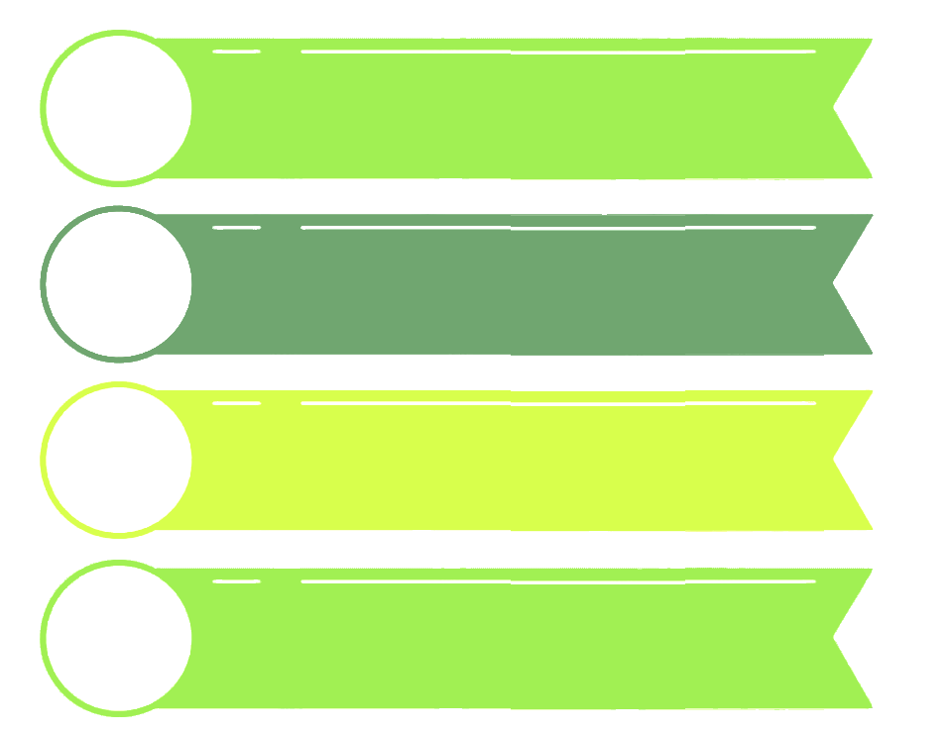

Golden Traits for Success in Life & Learning
1
Consistency
2
Discipline
3
Problem Solver
4
Curiosity
Notes:
Consistency - Regular practice is key to learning.
Discipline - Attend every session on time and complete homework.
Curiosity - Always ask questions, be eager to learn more.
Practice - The more you practice, the better you understand. 🔹 Problem Solver – Don’t just ask what, ask why and how. 🔹 Confidence – Believe in your ability to grow and improve. 🔹 Patience – Learning takes time. Stay steady. 🔹 Responsibility – Take charge of your learning. 🔹 Growth Mindset – Mistakes help you learn. Embrace them.

Slide 3

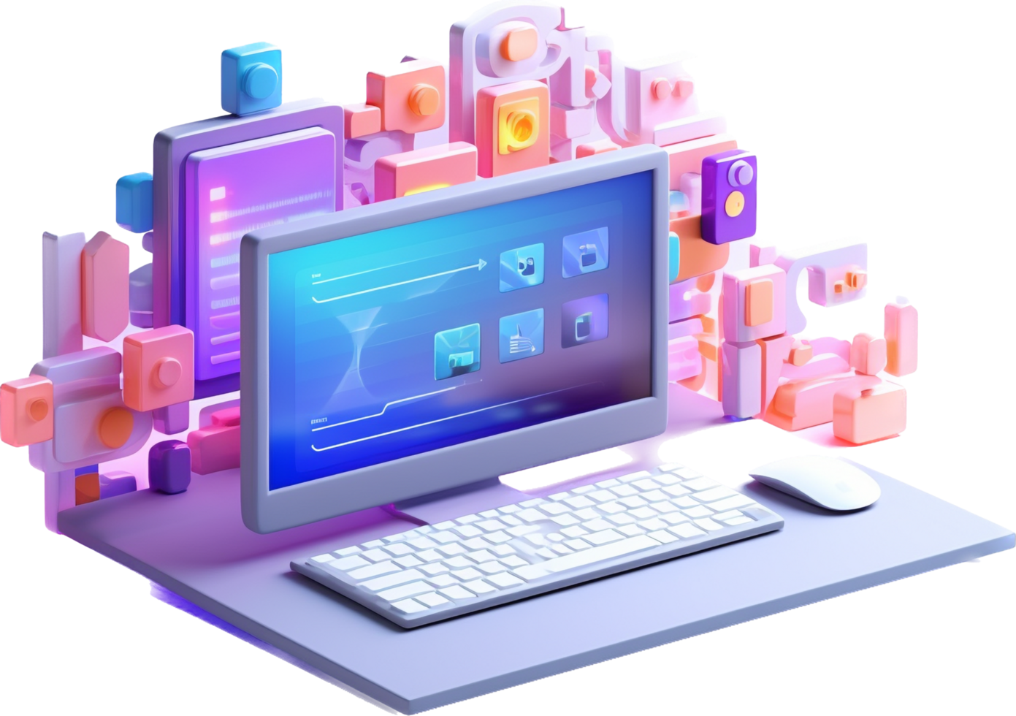
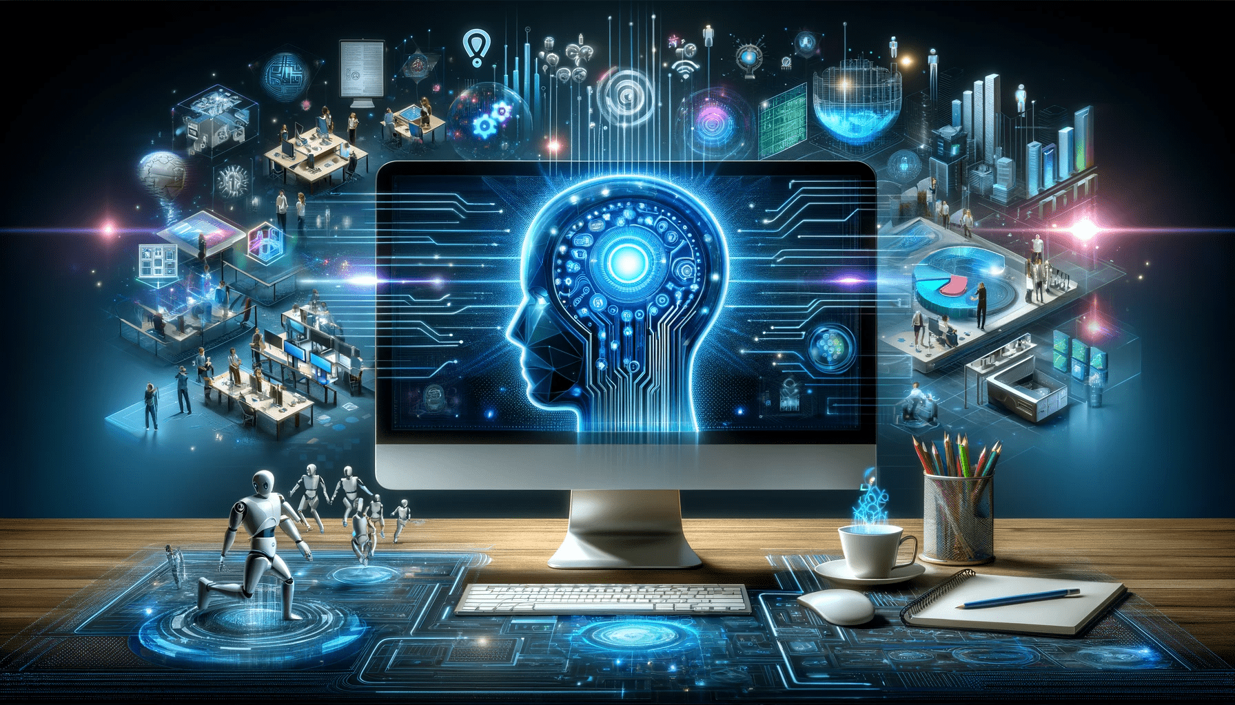
What is a Computer?
- A Computer is an electronic device that that accepts raw data (input), processes it according to instructions (processing), and produces meaningful results (output).
- It operates based on the INPUT → Processing → Output .
- Key Features:
✅ High Speed ✅ Accuracy ✅ Large Storage Capacity ✅ Automation (works with minimal human intervention) ✅ Versatility (can perform a wide range of tasks)
Notes:
Electronic: A device that works using electricity to process or transfer information.
Ask ChatGPT
High Speed: It can do calculations in microseconds.
Accuracy: Very few errors unless the human makes a mistake.
Large Storage: You can store thousands of files, photos.
Automation: You can set alarms, scheduled tasks.
Versatility: From gaming to studies, one device does it all.

Slide 4
Classification of Computer
Based on Work
Analog
Digital
Hybrid
Based On Size
1. Embedded Computer
2. Micro Computer
3. Mini Computer
4. Mainframe Computer
5. Suber Computer

Slide 5

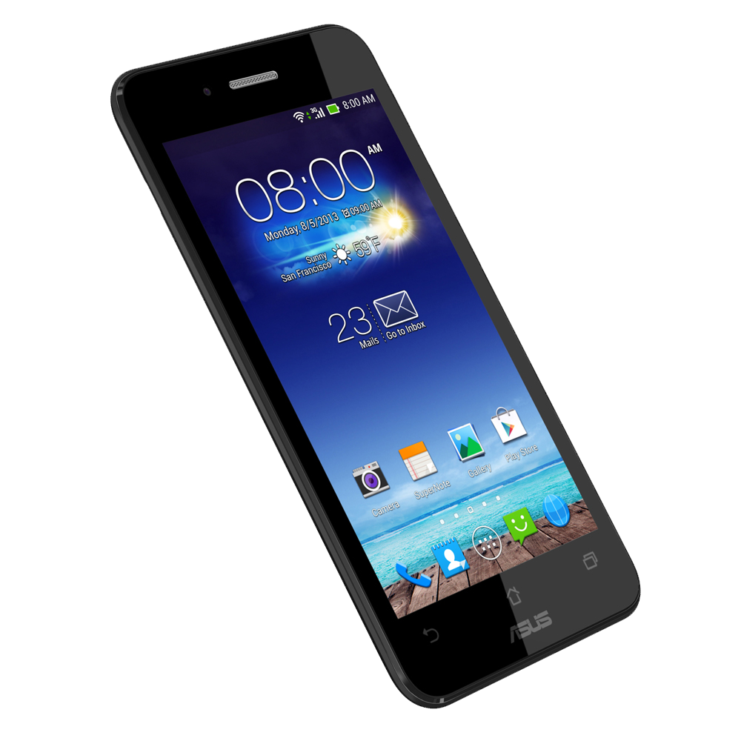
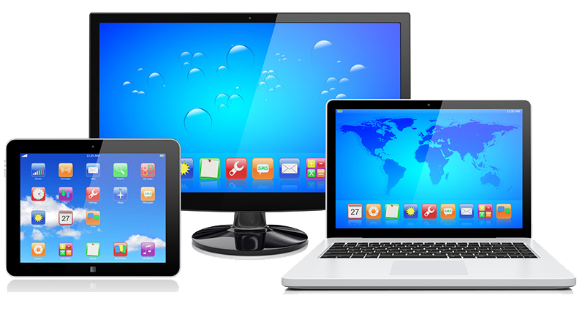
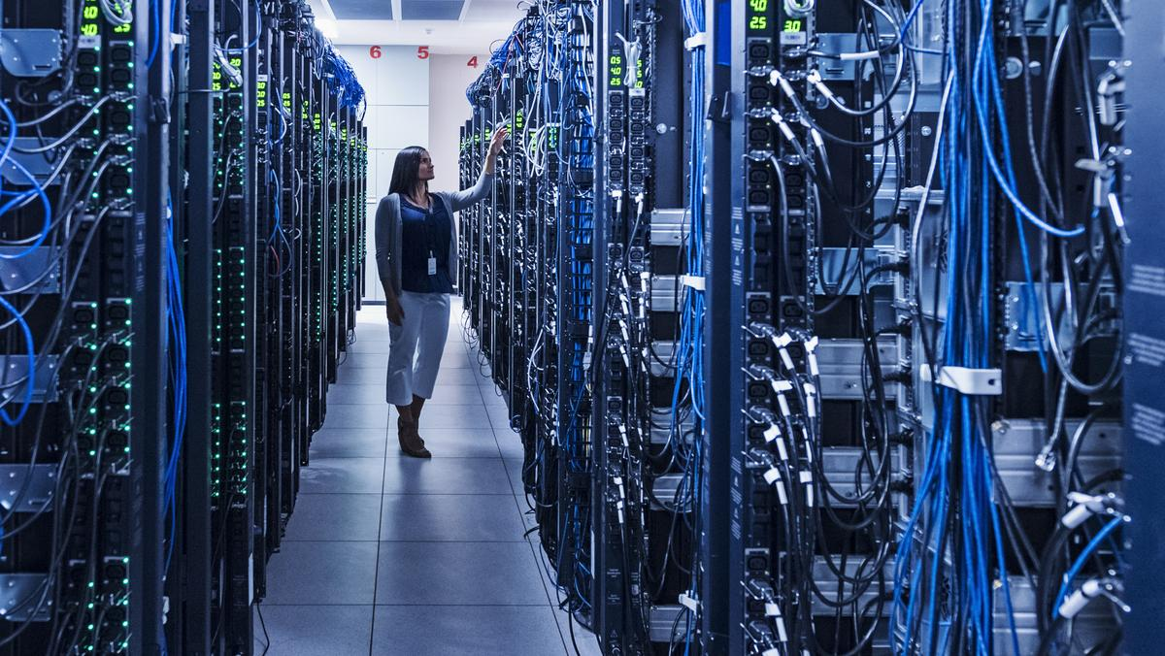
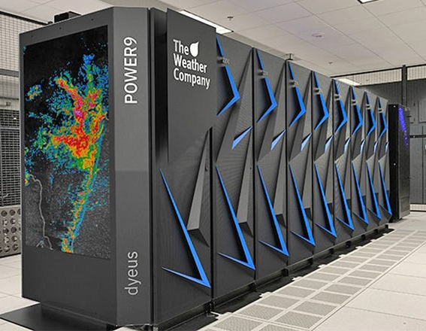
Types of Computers
- Desktop, Laptop, Tablet
- Smartphone, Server, Supercomputer
Notes:
Desktop: Home and office PCs.
Laptop: Portable, foldable PCs.
Tablet: Touchscreen computers.
Smartphone: Mini computers in your hand.
Server: Powerful computers that manage data for multiple users.
Supercomputer: Used in research, weather prediction, extremely fast.

Slide 6

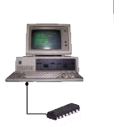
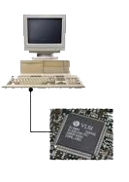
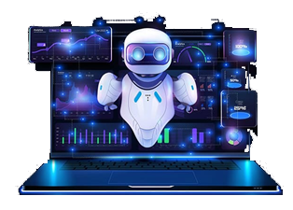
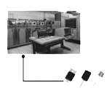
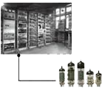
Generations of Computers
1st Gen: Vacuum Tubes (ENIAC)
2nd Gen: Transistors (IBM 1401)
3rd Gen: ICs (IBM 360)
4th Gen: Microprocessors (Intel-based PCs)
5th Gen: AI & ML (Smart Assistants)

Slide 7

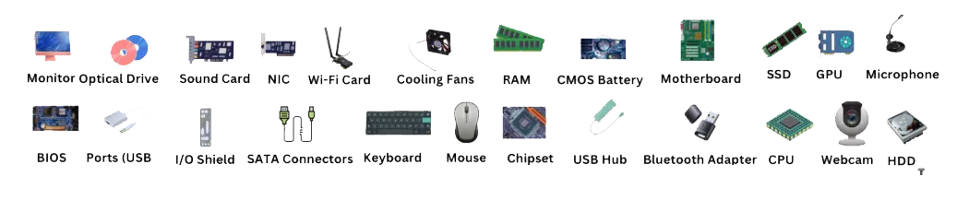
Computer Hardware Components
Input Devices: Keyboard, Mouse, Scanner
Output Devices: Monitor, Printer, Speaker
Processing: CPU (ALU + CU), RAM, Motherboard
Storage: HDD, SSD, USB, CD/DVD
Notes:
Input Devices: Things we use to give input (Keyboard, Mouse, Scanner).
Output Devices: Things through which computer gives results (Monitor, Printer, Speakers).
Processing Unit: CPU is like the brain.
ALU (Arithmetic Logic Unit): Does calculations.
CU (Control Unit): Controls operations.
RAM: Short-term memory.
Motherboard: Connects everything.
Storage Devices: Long-term memory (HDD, SSD, Pen Drive, DVD).

Slide 8

Types of Software
1. System Software: Windows, Linux
2. Application Software: MS Office, Browsers
3. Utility Software: Antivirus, WinRAR
Notes:
System Software: Helps computer run — Windows, Linux.
Application Software: Apps for users — MS Word, Chrome, games.
Utility Software: Maintains system health — Antivirus, WinRAR.

Slide 9

Operating System Basics
- Interface between user and hardware
- Manages files, memory, hardware
- GUI Elements: Start Menu, Taskbar, File Explorer
Notes:
OS is like a manager between you and the computer.
Helps you manage files, use software.
GUI Elements: Start Menu, Taskbar, File Explorer — you will show these during practical session.

Slide 10



Hands-On Practical Tasks
- Create folders & subfolders
- Rename, copy, move, delete files
Take a screenshot (PrtScn or Snipping Tool)
- Change wallpaper, adjust settings
Adjust volume, brighhtness
- Check system properties in 'This PC'

Slide 11

Q&A + Recap
Q1: Hardware vs Software?
Q2: Which gen introduced microprocessors?
Q3: Give 2 utility software examples
Q4: What is a computer?
Q5: Generations, Types, Hardware, Software
Q6: Windows OS Navigation + Hands-On
Notes:
Hardware vs Software: Hardware = physical, Software = programs.
Which gen introduced microprocessors? 4th Gen.
Utility Software examples: Antivirus, WinRAR.

Slide 12



Activity / Homework
Class Activity:
- Identify hardware parts
- Explore Windows GUI, Change desktop wallpaper
- Create a folder named Workshop Day 1 and subfolders: Notes, Images, Assignments
Homework:
- List the 5 generations of computers with key technology used in each.
- Find your phone's OS
- List 5 input/output devices.
- Write 3 differences between Hardware and Software.

Slide 13



